Slide 1
ACM 2.6 Walkthrough

Slide 2
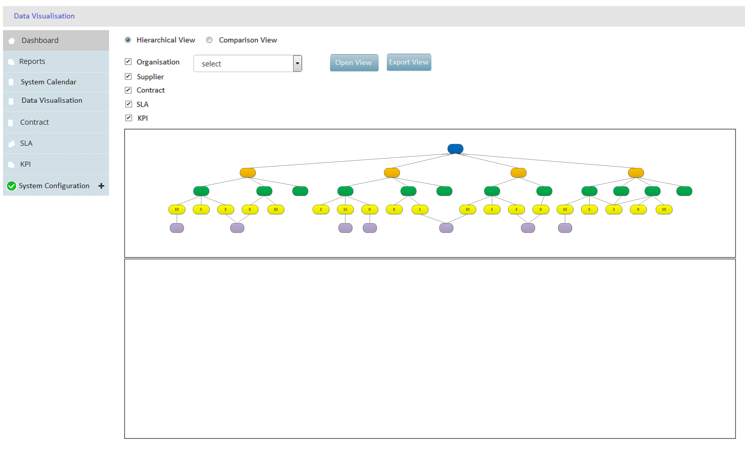
Display Panel
On hover and Display Panel:
For Supplier (orange icon) = Supplier name, year end date, risk, total spend
For Contract (green icon) = Contract name, number, value, start date, end date, risk, RAG status, # green alerts, # amber alerts, # red alerts
For SLA (yellow icon) = SLA name, basis (email or data), type, review date, service credit, cost to rectify, cost to business, # of triggers
For KPI (purple icon) = KPI name, type, description
Print function.

Slide 3
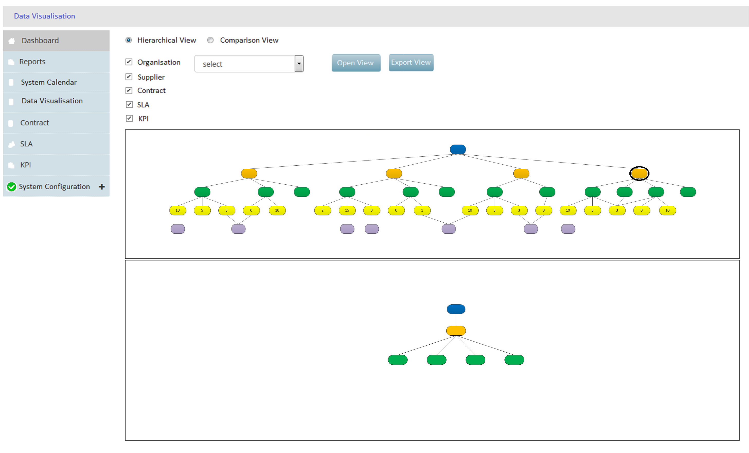
Display Panel
On click, show objects related to it

Slide 4
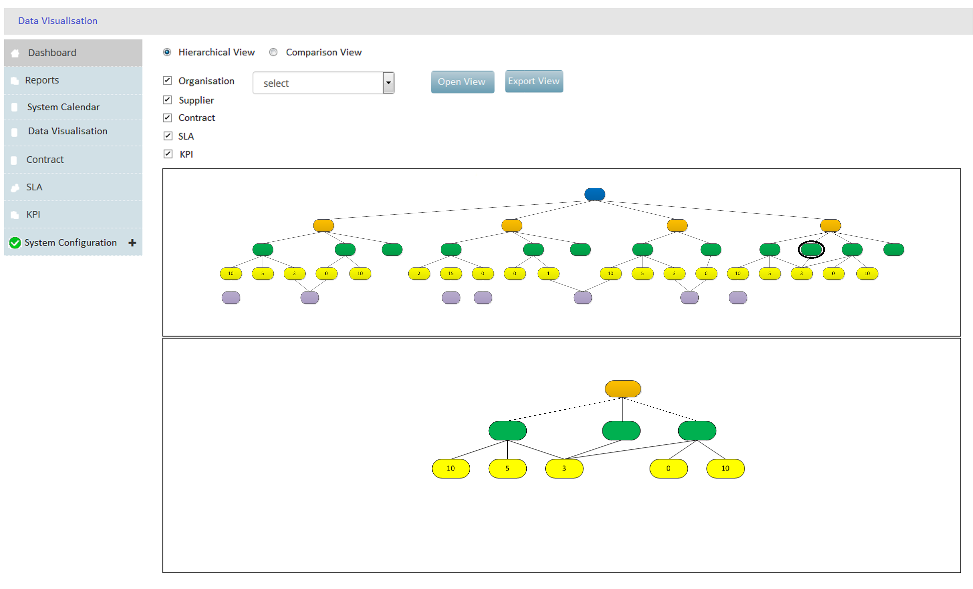
Display Panel
On click, show objects related to it

Slide 5
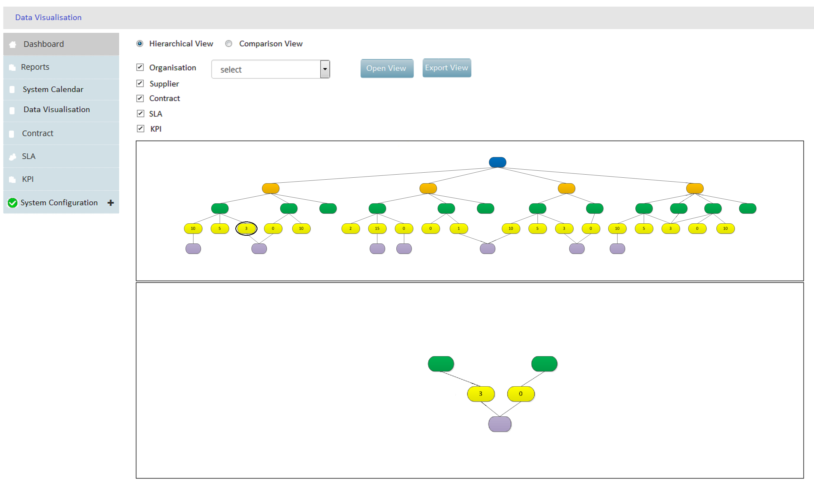
Display Panel
On click, show objects related to it

Slide 6
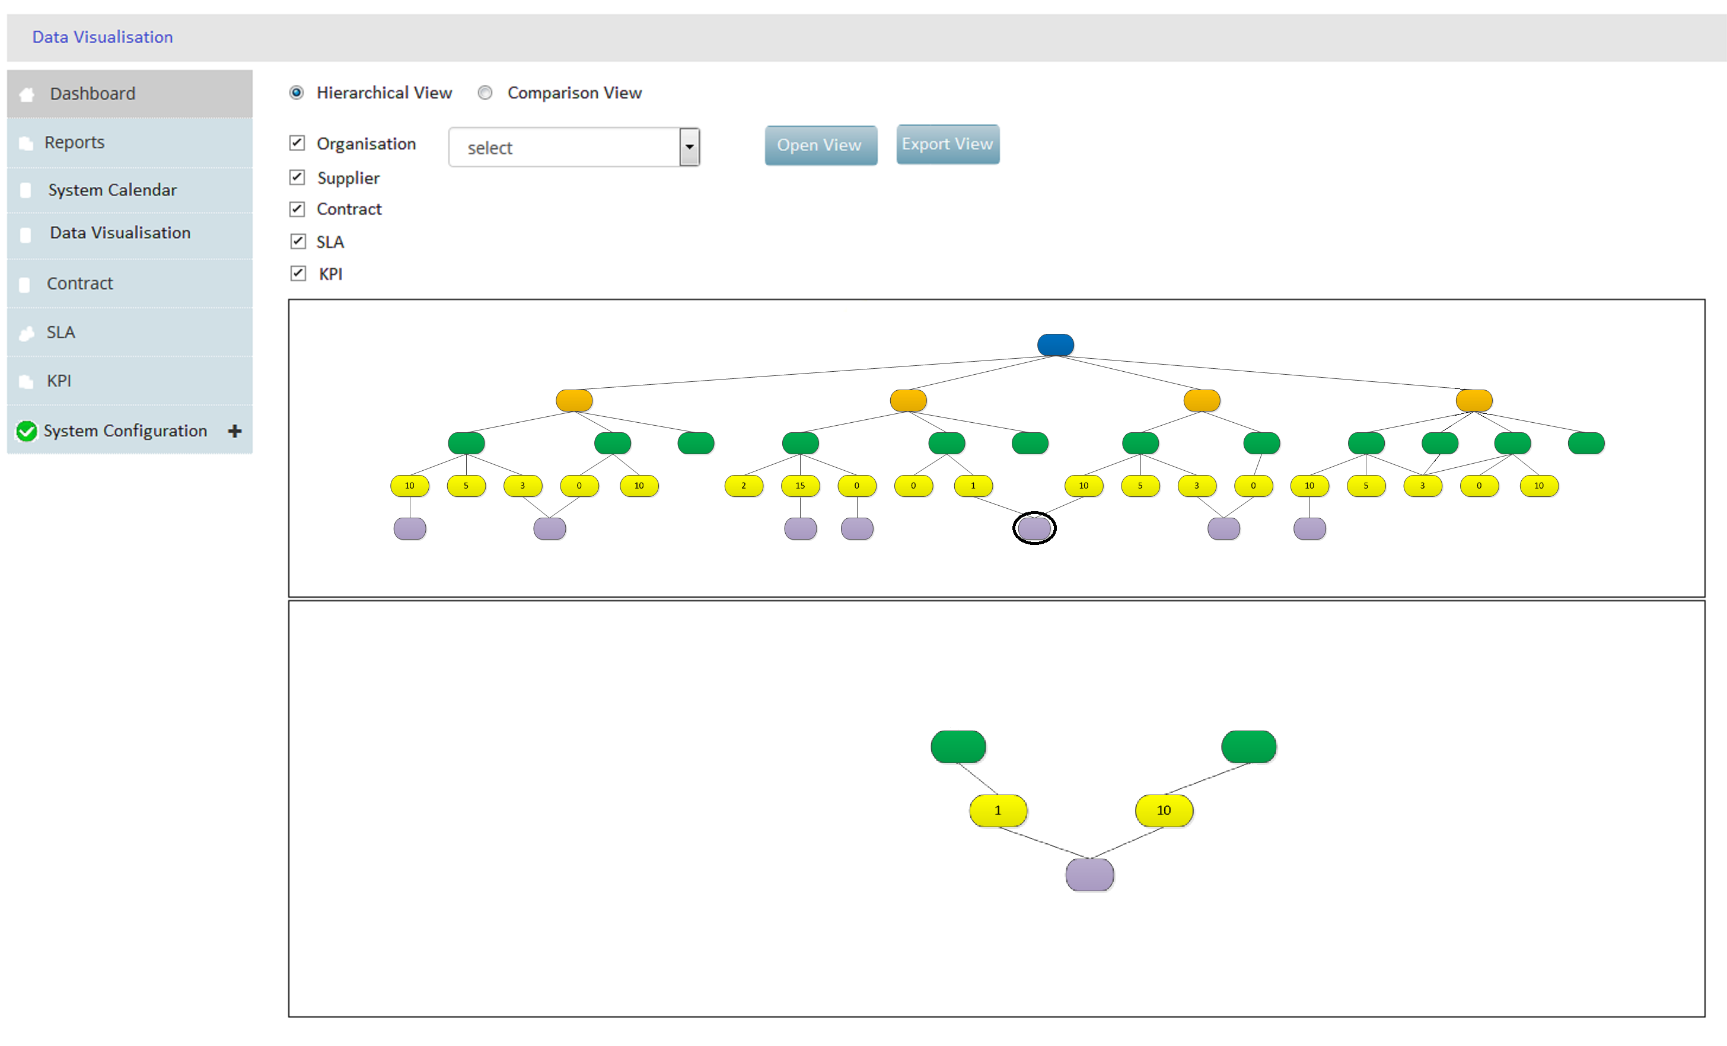
Display Panel
On click, show objects related to it

Slide 7
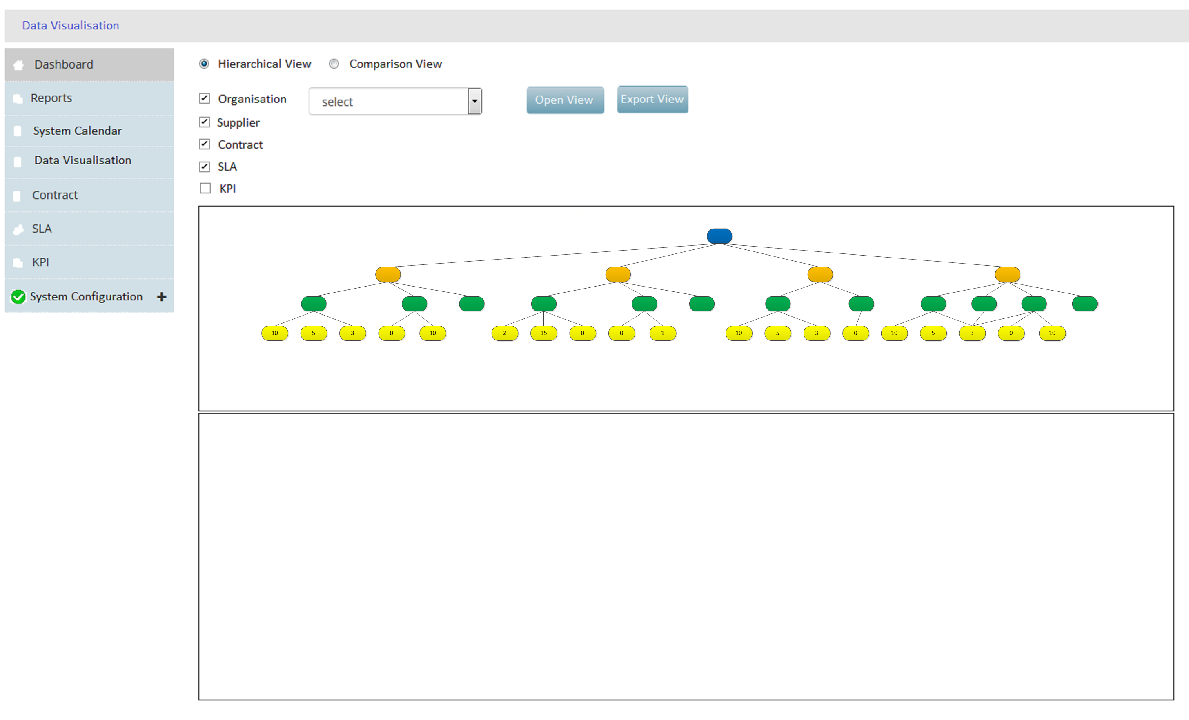
Display Panel

Slide 8
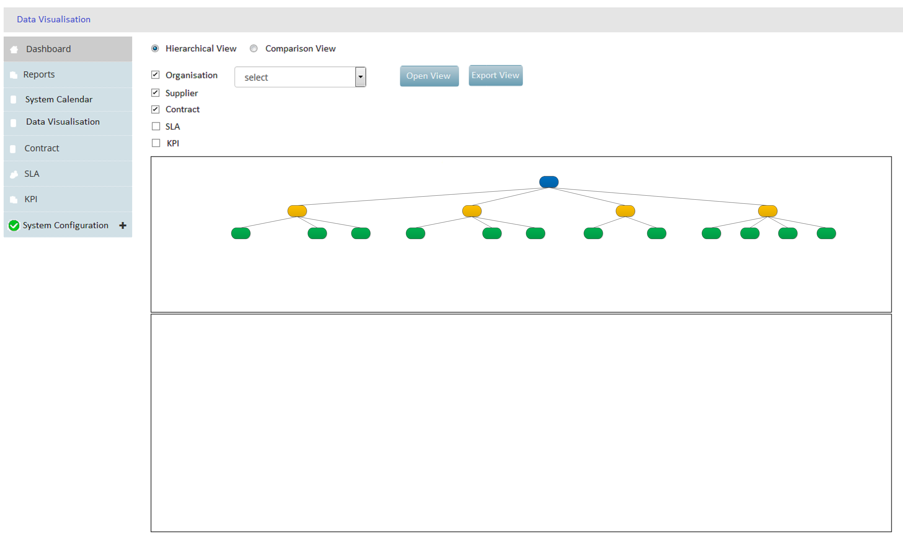
Display Panel

Slide 9

Display Panel

Slide 10
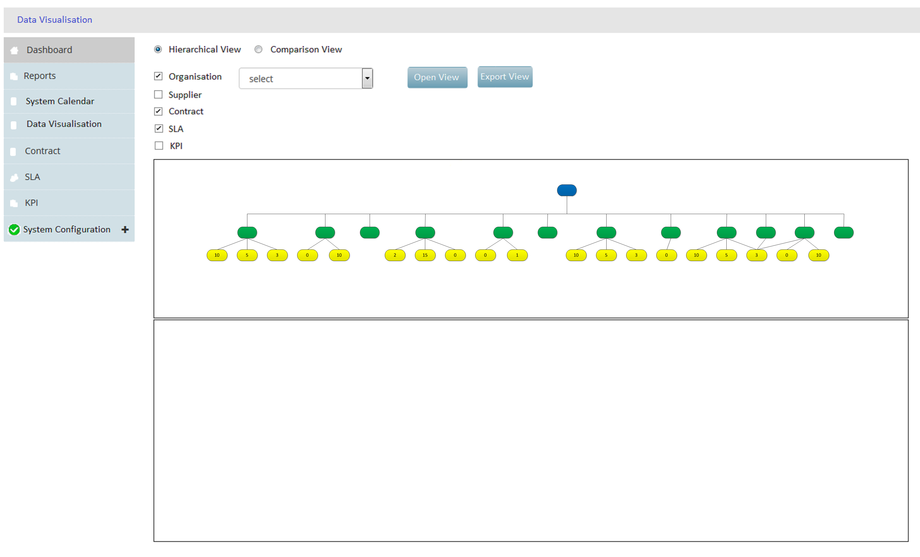
Display Panel

Slide 11
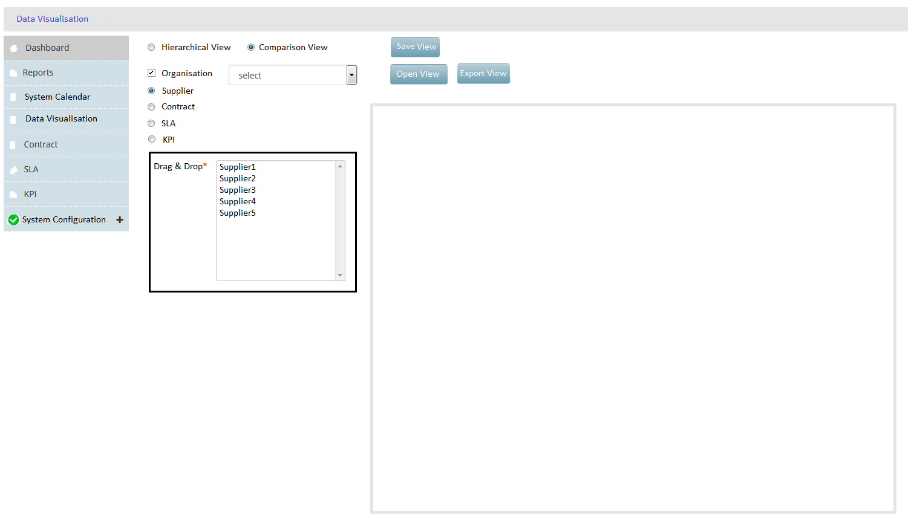
Select 1
Select 2
Select 3
On hover, and on display panel:
For Contract = Contract name, number, value, start date, end date, risk, RAG status, # of green triggers # of amber triggers, # of red triggers
For SLA = SLA name, basis (email or data), type, review date, service credit, cost to rectify, cost to business, #triggers
For KPI = KPI name, type, description
Display Panel

Slide 12
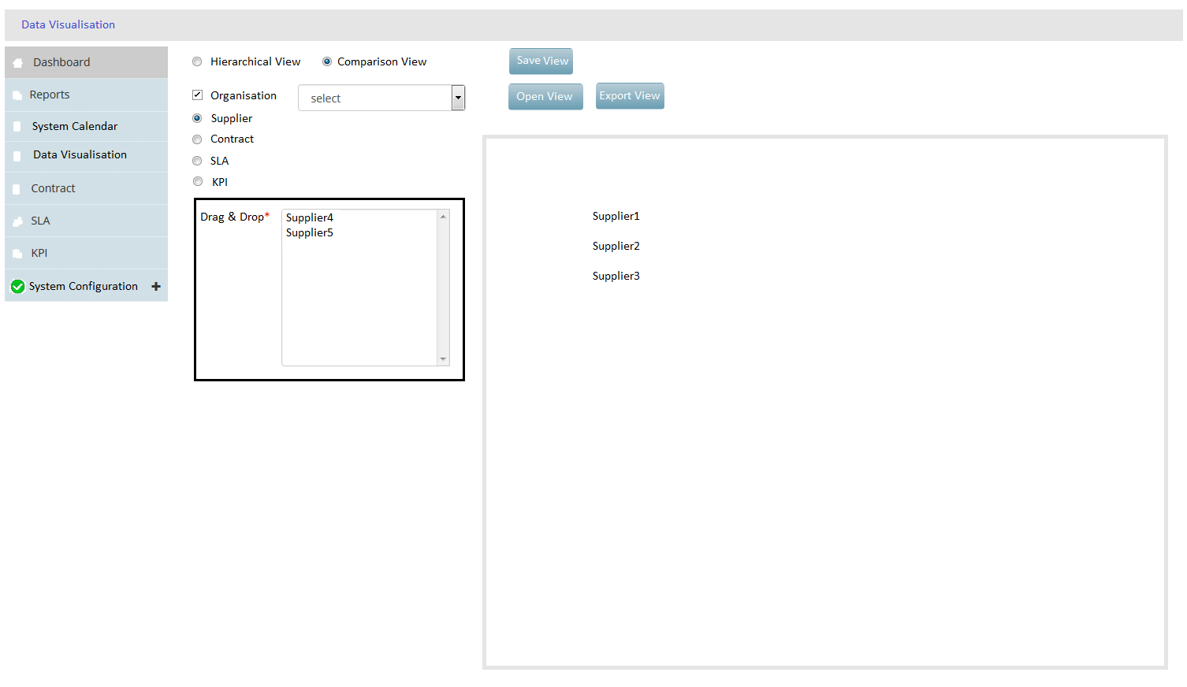
Supplier 1
Supplier 2
Supplier 3
Display Panel

Slide 13
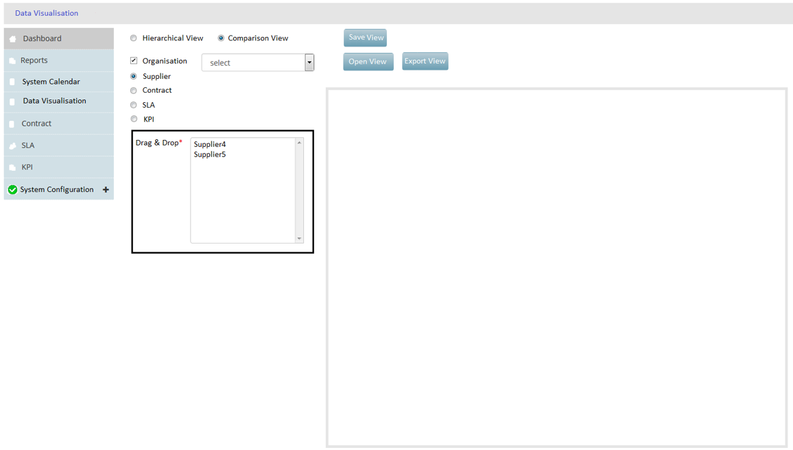
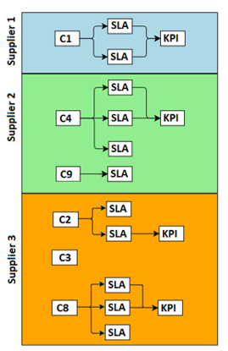
Summary of Suppliers: Year end date, risk, total spend, total # contracts
On hover, and on display panel:
For Contract = Contract name, number, value, start date, end date, risk, RAG status, # of green triggers # of amber triggers, # of red triggers
For SLA = SLA name, basis (email or data), type, review date, service credit, cost to rectify, cost to business, #triggers
For KPI = KPI name, type, description
Display Panel

Slide 14
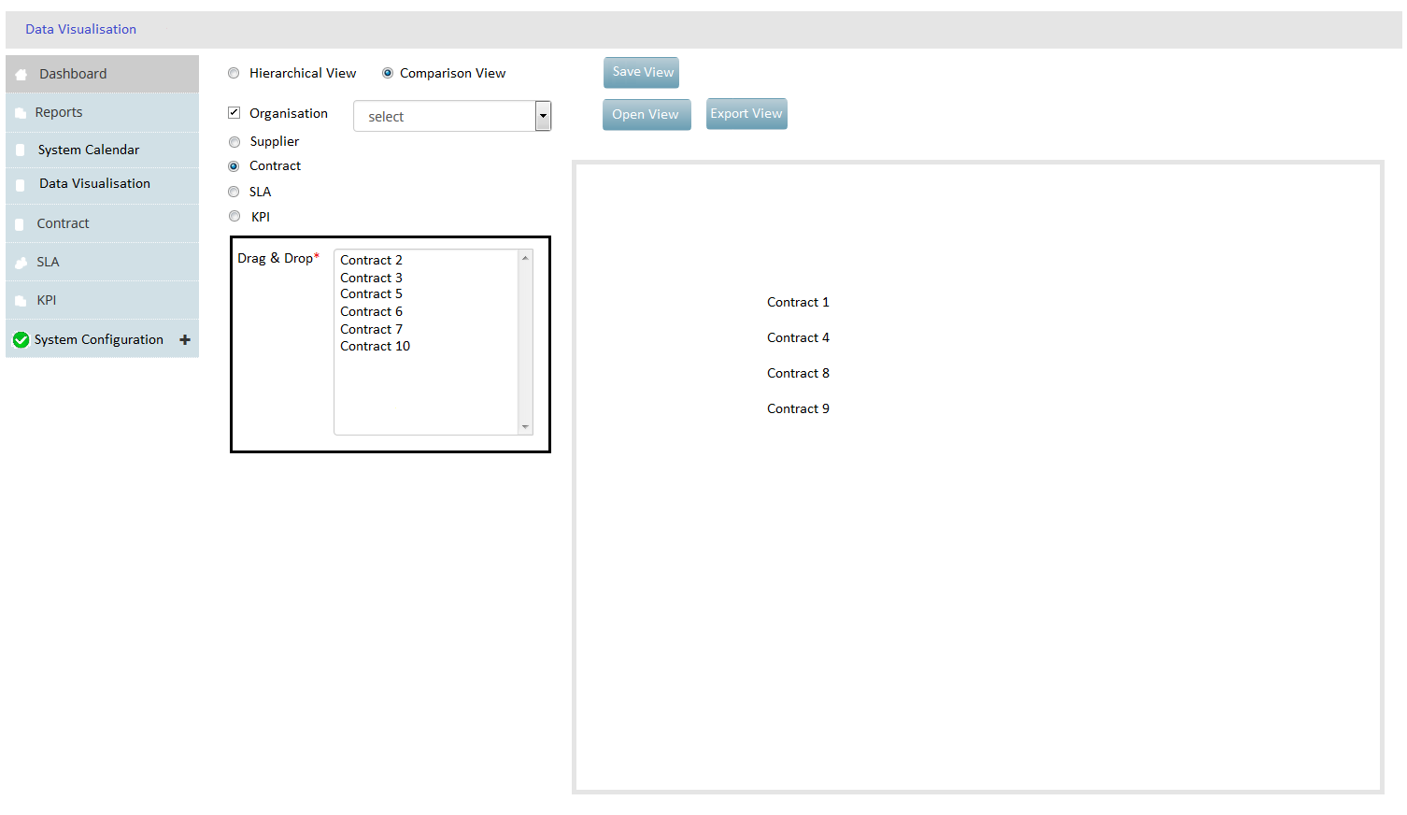
Select 1
Select 2
Select 3
Display Panel

